Slide 1
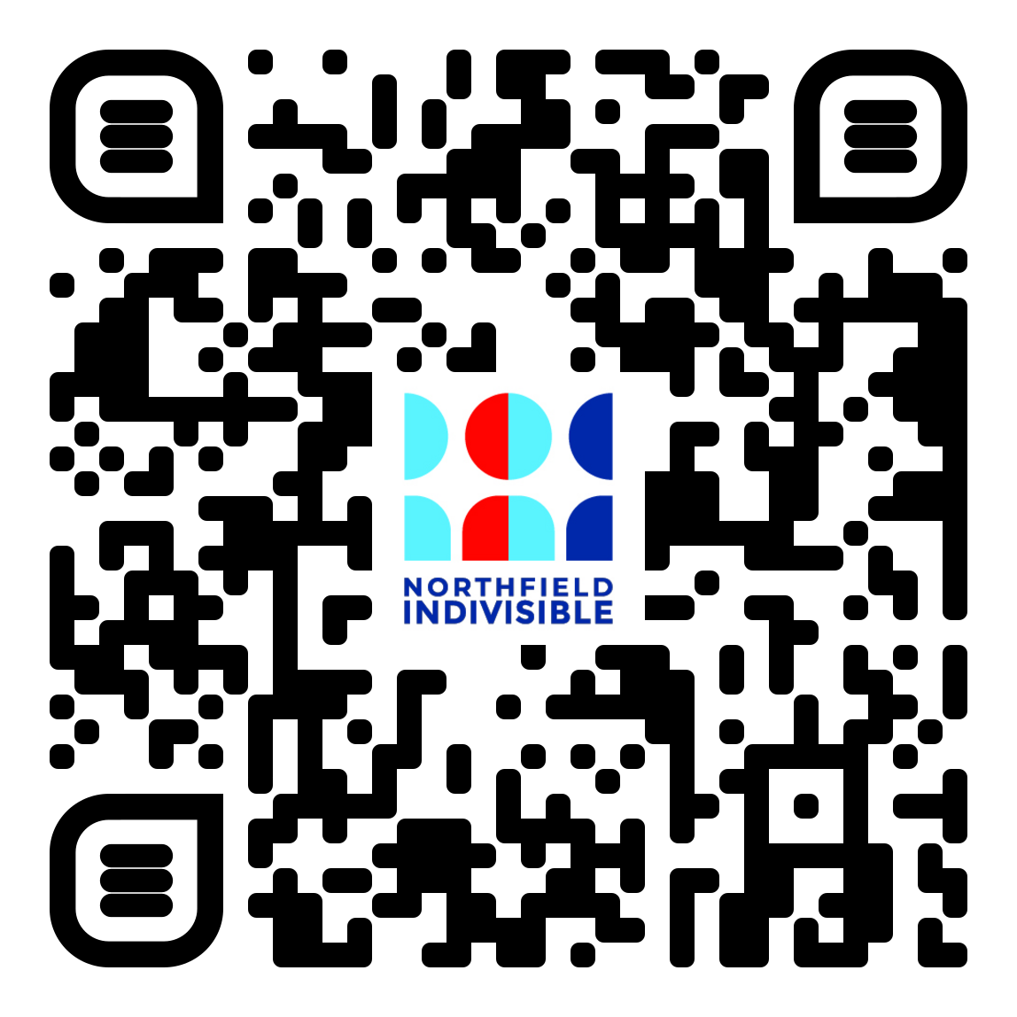
Welcome, News & quick updates – 5 minutes
Sign up for a Team:
(aka, committee, working group, action club, hangout with friends, etc.)

Slide 2
Names & faces
Mental Health
Nfld Indivisible @Imminent Social Hour
Fridays @ 4:30?
No Kings 3 = March 28
Call Congress and demand serious DHS reform, (defund & abolish ICE), and vote against, block or otherwise keep the “SAVE” act from passing. (and let’s not forget about the Epstein files!)

Slide 3
Recap of 1/12 & 1/26 meetings – 5 minutes
1/12 – in person
Announcements & Updates
Safety & Event Planning
Caucus Prep
Matt Little
Anti-BDS Law Resolution, (specifically boycotts of Isreal)
Recent Event Reflection
ICE Presence & Community Response
Next Steps

Slide 4
Recap of 1/12 & 1/26 meetings – 5 minutes
1/26 – Online
Recapped the 1/12 meeting
Focused on Teams and conversations surrounding actions.

Slide 5
ICE Report – 10 minutes
It’s complicated in Nfld – NSN
Other opportunities can be found here: https://linktr.ee/mn50501

Slide 6
Teams overview – 5 minutes
Leadership Committee – sets priorities, keeps us aligned, manages internal communication.
Election Influence Committee – voter engagement, candidate support/vetting, concise policy guidance.
Community Outreach & Liaison Committee – partnerships with local groups, coalition-building, inclusion.
Rally & Events Committee – plans rallies/events, logistics/permits, speakers/safety, volunteers.
Communications & Social Media Committee – messaging, press outreach, rapid response, social media/analytics.
Fundraising & Finance Committee – fundraising campaigns, donor relationships, budgets/financial records.
Training / New Members / Membership Committee – onboarding, training/orientation, member engagement.
Special Interest / Working Groups – issue-based teams for specific campaigns/policy areas.

Slide 7
Teams engagement and group formation – 5 minutes
Focusing on 4 main groups tonight:
Community Outreach and Liaisons -- Partnerships with local groups, coalition-building, inclusion
Communications and Social Media – Messaging, press outreach, rapid response, social media/analytics
New Members and Training – Onboarding, training and orientation, member engagement.
Special Interest Working Groups – Issue-based teams for specific campaigns and policy areas.

Slide 8
Community Outreach & Liaison Committee – partnerships with local groups, coalition-building, inclusion.
Those who signed up already:
Phil Kasten
Joel Weisberg
Shelley Sake
Mike Sake

Slide 9
Communications & Social Media Committee – messaging, press outreach, rapid response, social media/analytics.
Those who signed up already:
Cora Dohm-Palmer
Joy Riggs
Kathleen Schmidt

Slide 10
New Members and Training – Onboarding, training and orientation, member engagement.
Those who signed up already:
Wendell Refior
Vanessa Bodrie
Shelley Sake

Slide 11
Special Interest Working Groups – Issue-based teams for specific campaigns and policy areas.
Those who have signed up already:
Doug Waechter

Slide 12
Break into small groups, share contact info and introductions. – 20 minutes
Come up with 3 action items that the team will work on over the next month.

Slide 13
Q & A – 10 minutes

